Slide 1
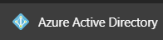
Module 4 Azure Active Directory
Section 1 - Introduction & concepts
June 2018

Slide 2
Agenda Module 4 – Section 1 : Introduction & concepts
01
Introduction An overview of Azure Active Directory (why/what)
Azure AD Editions Introduction to the different Azure AD editions and their related features
05
02
Azure AD & AD DS Review of the differences between AAD and Active Directory Domain Services
06
On-prem Identity integration models Introduction to the different Azure AD authentication models
03
Azure AD Design Quick overview about Azure AD Design and its anatomy
07
Azure AD Authentication basics Principle of the Azure AD authentication
04
Key Concepts & Terminology Review of the different key concepts and the terms to know
08
Azure AD & identity management How to manage Azure AD
Notes:
AAD stands for Azure Active Directory

Slide 3




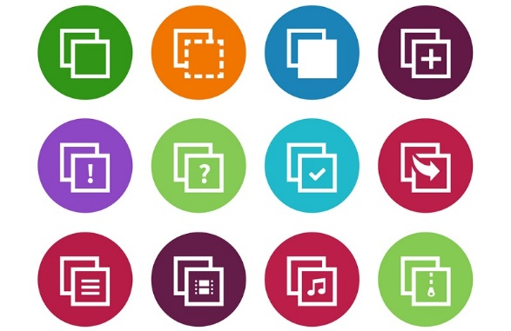

Why Azure AD ?
What users want…
Any Device
Any Place
Any time
To all their apps (including on-prem)
Using their corporate identity
Notes:
Identity Modernization Context,
Users want to access information from any device at any place and any time.
Single Identity to all apps, and the most seamless experience possible.
Organizations want to enable users anywhere by protecting their Intelectual property

Slide 4

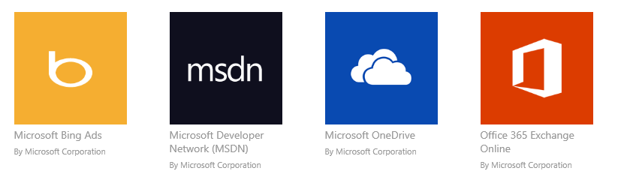


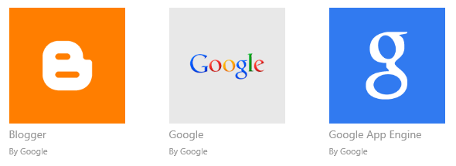

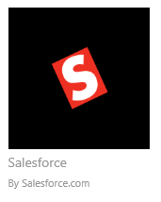

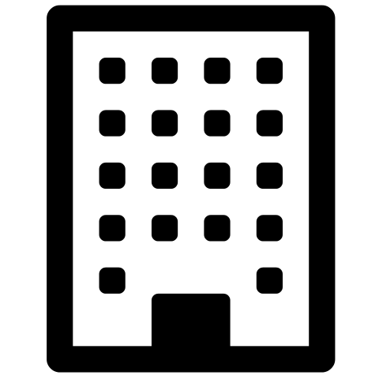




Why Azure AD ?
What IT wants to solve …
IT challenges :
Mutiples Identities
or multiple Trusts for multiple Apps
Complicated Device access to SaaS Apps management :
Multiple Access Policies for each device
Ensure security compliance of each device
Trusts
On Premise Apps
Old approach 1: Create Separate accounts for each SaaS Apps
Old approach 2 : Create separate federation trusts with SaaS Providers
EC2
force.com
Amazon.com
AWS
System Center
Salesforce.com
Private cloud

Slide 5



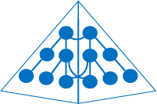

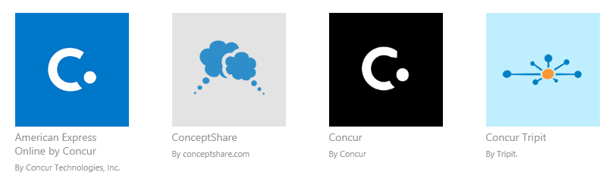
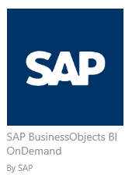
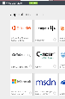
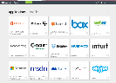
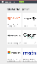
Microsoft Approach : Unified Identity and Access Management
Microsoft apps
Active Directory
Active Directory
On-Premises user accounts can be synchronized with Azure ADConnect (Providing Users with a Common Identity )
Non-MS SaaS Aps
This enables users to access MS/Non-MS SaaS and published on premise applications
Published On Premise Applications
PCs and devices
Enrich Identity and Access Management
Self Service Password Reset
Multifactor Authentication
Group Based Application Access
Self Service Group Management
Dynamic Group Management
Conditional access
Enables seamless access from any device
Azure AD and On-Prem ADFS access control policies can be implemented for the devices
Intune ensures the security compliance and effective MDM for the devices

Slide 6
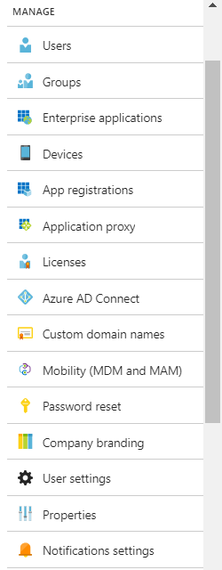
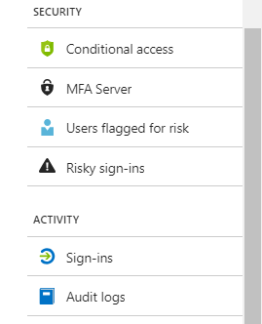
What is Azure Active Directory (Azure AD) ?
Azure AD is Microsoft’s multi-tenant, geo-distributed, cloud based directory and identity management service. It combines
Cloud based directory services,
Azure AD is the centralized directory store containing all users identities (of your organisation)
REST-based Graph API
Advanced cloud identity governance,
Allows the creation and management of users, groups, devices, applications, and roles
Extends, expands benefits of Active Directory into the cloud
Token based authentication to provide secure access to rich apps
Provides features such as MFA, , device registration, Password Reset, and Control of Branding during sign in to Office 365 and Azure
application access management
Architected to meet the needs of modern cloud applications (Supports modern authorization & authentication scenarios
Enables single sign-on to many different SaaS applications
Using standardized protocols like SAML 2.0, OpenID Connect, and OAuth 2.0
Supports automatic provisioning, de-provisioning, and life cycle management of user accounts for popular apps, using API connectors and standardized protocols like SCIM
and a rich standards-based platform for developers
Cross platform and standards based – Support for popular clients and many server/service platforms.
Reduces or removes custom security implementation : Authenticating users / Detecting suspicious activity / Authorizing users via Groups or Roles (RBAC)
Fast and easy to sign up to – create a new directory in < 2 minutes
Notes:
What is Azure AD:
Azure AD is Microsoft’s multi-tenant, cloud based directory and identity management service. Azure AD is the centralised directory store used by Azure and Office 365, containing all the identities of users inside your organisation.
It combines directory services, advanced identity governance, application access management and a rich standards-based platform for developers
References :
https://docs.microsoft.com/en-us/azure/active-directory/active-directory-whatis
What is Azure AD? Watch this video
http://azure.microsoft.com/en-us/documentation/videos/azure-active-directory-overview/
https://azure.microsoft.com/fr-fr/resources/videos/teched-europe-2014-cloud-identity-microsoft-azure-active-directory-explained/
AAD Editions
https://msdn.microsoft.com/en-us/library/azure/dn532272.aspx
Office365+AAD
http://blogs.office.com/2015/02/17/sign-page-branding-cloud-user-self-service-password-reset-office-365/

Slide 7
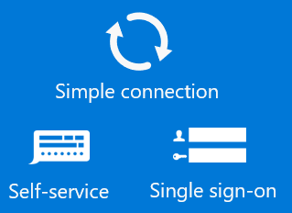


Azure AD : The Big Picture : Identity as the core of enterprise mobility
Access
Management
Multi-Factor
Authentication
Privileged Identity
Management
Other directories
Windows Server
Active Directory
Identity Protection
Conditional
Access
Azure
SaaS
ADFS
Public
cloud
Azure AD Connect
On-Premises
Microsoft Azure Active Directory
Cloud
BYOD
A modern identity management system spanning cloud and on-premises, providing federation, identity management, device registration, user provisioning, application access control & data protection.

Slide 8
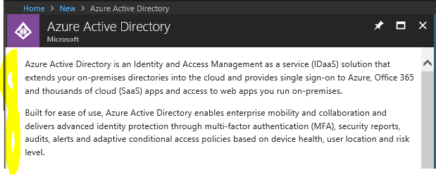
Azure AD definition from the Azure portal itself

Slide 9





Azure AD benefits
Identity and access management for employees, partners, and customers
John Doe
lllllll
Provide seamless access
Facilitate collaboration
Unlock IT efficiencies
Enhance security and compliance
Notes:
Microsoft built Azure Active Directory to be the best cloud identity service for customers. Cloud identity should:
Empower employees to connect to all their content and apps, while gaining unified management and control of cloud and on-premises resources and data.
Extend access to resources beyond your own users, to enable secure collaboration with partners and customers.
Lower IT overhead with efficiencies that make IT more strategic. Keep your users happy by empowering them with self-service capabilities.
Respond to threats in real time with cloud-powered insights that identify, and address risk based on big data and machine learning.
Moreover, Security is at the heart of Azure AD.
Seamless access to all your apps in the cloud or on-premises
Empower employees to connect to all their content and apps, while gaining unified management and control of cloud and on-premises resources and data.
I can manage access to my cloud and on-premises resources in a unified way (hybrid)
Azure AD works out of the box with thousands of popular SaaS apps
I can easily set up custom apps to work with Azure AD
My end users will have easy access to all the apps they need (cloud and on-premises) from any device or location
Stay secure with cloud-powered protection
Respond to threats in real time with cloud-powered insights that identify, and address risk based on big data and machine learning.
I can have near real-time account monitoring and proactive security
Industry leading authentication methods like PIN, biometrics, app based or no passwords at all
I am ready for an assumed breach world
I will always be compliant with full transparent data & privacy settings and protection to privileged accounts
Enable secure collaboration within and beyond your walls
Extend access to resources beyond your own users, to enable secure collaboration with partners and customers.
I can enable my internal teams to collaborate seamlessly with each other
I can enable my team to collaborate seamlessly with partners and third-party vendors
I can provide external partners and vendors managed access to our corporate resources
Use B2C for customer facing apps
Empower IT efficiencies. Effortless to Use
Lower IT overhead with efficiencies that make IT more strategic. Keep your users happy by empowering them with self-service capabilities.
I can enable my end users to manage common tasks, like password reset and group management without needing to call IT
I can automate a lot of IT tasks related to lifecycle management
Experience is consistent across every service on any device, and is clearly attributed to Microsoft
No more passwords – biometric login to any service on any device

Slide 10
The difference between AD DS and Azure AD
Azure AD is a multi-customer public directory service, which means that within Azure AD you can create a tenant for your cloud servers and applications such as Office 365.
Users and groups are created in a flat structure without OUs or GPOs.
Authentication is performed through protocols such as SAML, WS-Federation, Oauth and OpenID Connect.
It's possible to query Azure AD, but instead of using LDAP you must use a REST API called AD Graph API. These all work over HTTP and HTTPS.
Be aware : Azure Active Directory domain concept is different than the AD DS Domain
In AD DS, domain is security, storage, and trust boundary
In Azure AD, domain is more synonymous with a DNS domain
Notes:
Source : https://docs.microsoft.com/en-us/azure/active-directory/understand-azure-identity-solutions#the-difference-between-windows-server-ad-ds-and-azure-ad

Slide 11
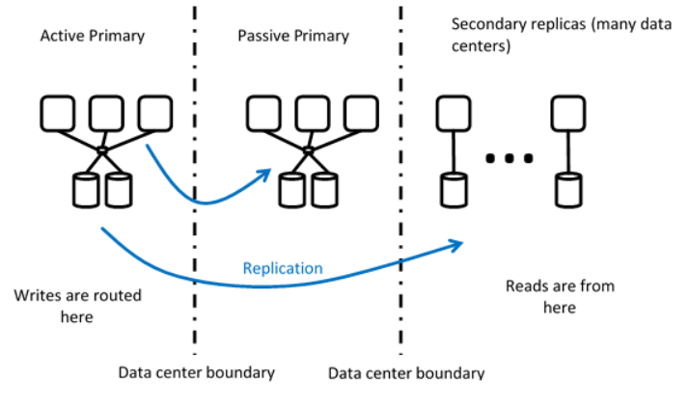
Azure Active Directory Design
AAD actually works as a system of an active primary, a passive primary, and then a number of secondary replicas that are replicated around the world.
Partitioned for scalability
Active/active across data centers for directory reads and authentication (token issuance)
Active/passive across data centers for directory writes
Recovery Time Objective (RTO)
Zero for reads and token issuance
About five minutes for writes
Notes:
AAD actually works as a system of an active primary, a passive primary, and then a number of secondary replicas that are replicated around the world. When writes are performed, they're performed at the active primary, then replicated, whereas reads can be performed against the primary or secondary replicas.
For more information, see : https://cloudblogs.microsoft.com/enterprisemobility/2014/09/02/azure-ad-under-the-hood-of-our-geo-redundant-highly-available-distributed-cloud-directory/

Slide 12
Azure AD internal architecture overview
Office 365
Azure
Dynamics
Intune
ISV apps
Custom apps
Authentication (EvoSTS)
On-Premises
Device Registration
Self-Service
Azure MFA
Directory graph (GraphAPI)
Admin Portal
SaaS App Mgmt
AAD Domain Services
AAD Connect
Synchronization
(AWS)
PowerShell
Identity Protection
AAD App Proxy
Core Directory Store (MSODS)
AD
Directory partitions
P1
P2
P3
P4
Tenants
Tenant1
Tenant3
Tenant5
Tenant7
Tenant2
Tenant4
Tenant6
Tenant8

Slide 13
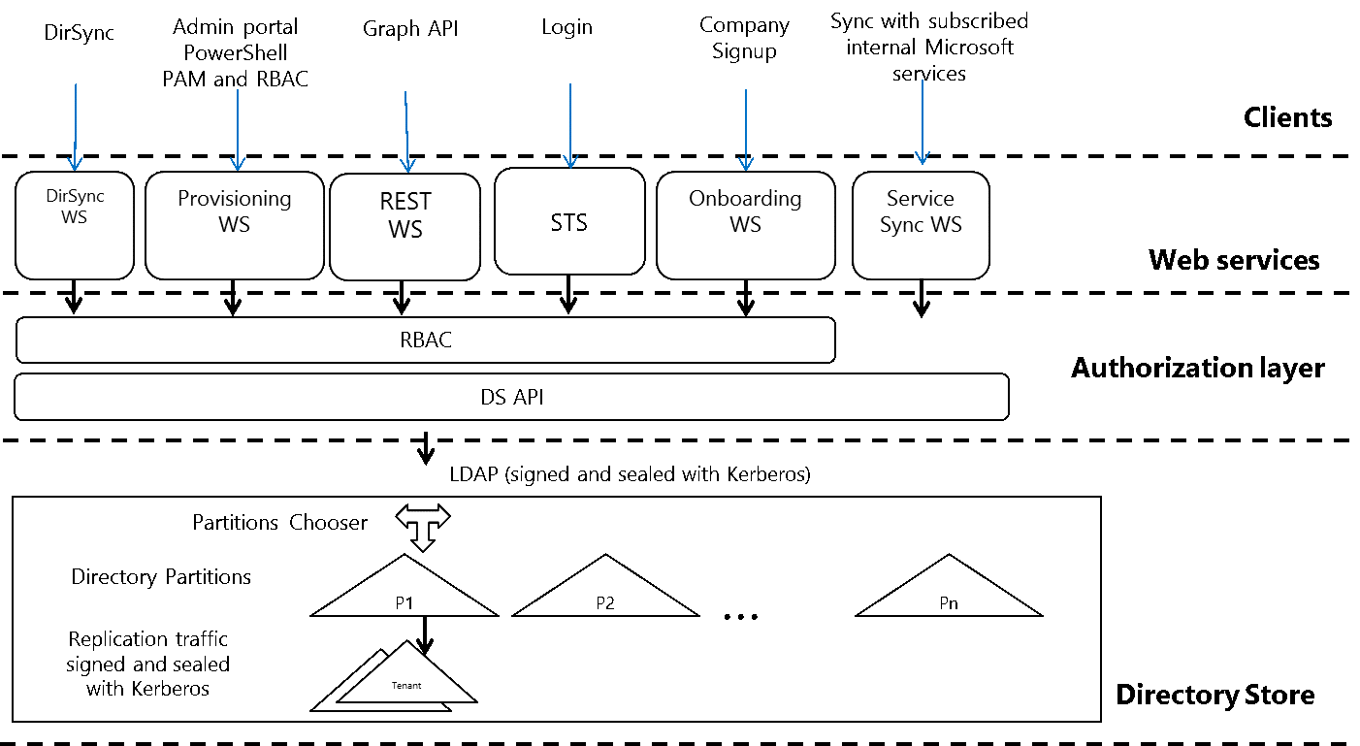
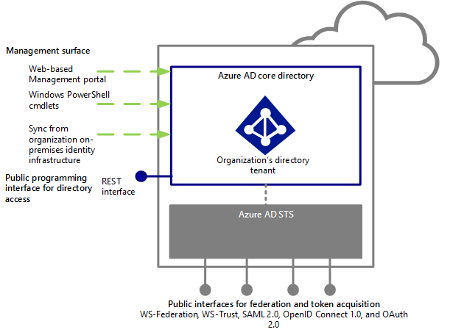
Anatomy overview of Azure AD
At the simplest level, Azure AD is a scalable directory infrastructure that provides for:
storage,
data access,
replication and synchronization,
device registration,
Authorization & Authentication (via its security token services (STS) sub component)

Slide 14
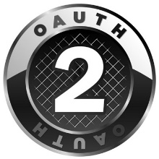




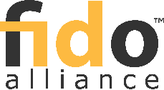
Standards based integration
OAuth2 & OpenID Connect
FIDO 2.0
REST based Graph API (OData 4.0 Compliant)
SAML
WS-Federation
Azure Active Directory
SCIM 2.0
WS-Federation
Strong support for modern, cross platform, cloud friendly API’s & protocols
Certification program for third party federation servers & services
Actively engaged in standards bodies (OAuth, OpenID, SCIM, etc.)
Notes:
aka.ms/Azure/Authentication
aka.ms/Azure/Protocols

Slide 15
key terms to know
Azure subscription
Subscriptions are used to pay for Azure cloud services and are usually linked to a credit card. You can have several subscriptions, but it can be difficult to share resources between subscriptions.
Azure Tenant
An Azure AD tenant is representative of a single organization. It is a dedicated, trusted instance of Azure AD that is automatically created when an organization signs up for a Microsoft cloud service subscription such as Azure, Intune, or Office 365.
Tenants can gain access to services in either a dedicated environment (single tenant) or in a shared environment with other organizations (multitenant).
Azure AD directory
Each Azure tenant has a dedicated, trusted Azure AD directory that contains the tenant’s users, groups, and applications. It is used to perform identity and access management functions for tenant resources. Because a unique Azure AD directory is automatically provisioned to represent your organization when you sign up for a Microsoft cloud service like Azure, Microsoft Intune, or Office 365, you’ll sometimes see the terms tenant, Azure AD, and Azure AD directory used interchangeably.
Custom domain
When you first sign up for a Microsoft cloud service subscription, your tenant (organization) uses an .onmicrosoft.com domain name. However, most organizations have one or more domain names that are used to do business and that end users use to access company resources. You can add your custom domain name to Azure AD so that the domain name is familiar to your users, such as alice@contoso.com instead of alice@contoso.onmicrosoft.com.
Notes:
Source : https://docs.microsoft.com/en-us/azure/active-directory/understand-azure-identity-solutions

Slide 16
Terms to know (various accounts)
Azure AD account
These are identities that are created by using Azure AD or another Microsoft cloud service such as Office 365. They are stored in Azure AD and accessible to any of the organization’s cloud service subscriptions
Azure subscription administrator
The account administrator is the person who signed up for or bought the Azure subscription. They can use the Account Center to perform various management tasks like create subscriptions, cancel subscriptions, change the billing for a subscription, or change the Service Administrator.
Azure AD Global administrator
Azure AD Global administrators have full access to all Azure AD administrative features. The person who signs up for a Microsoft cloud service subscription automatically becomes a global administrator by default. You can have more than one global administrator, but only global administrators can assign any of the other administrator roles to users.
Microsoft account
Microsoft accounts (created by you for personal use) provide access to consumer-oriented Microsoft products and cloud services, like Outlook (Hotmail), OneDrive, Xbox LIVE, or Office 365.
These identities are created and stored in the Microsoft consumer identity account system run by Microsoft.
Work or school accounts
Work or school accounts (issued by an admin for business/academic use) provide access to enterprise business-level Microsoft cloud services, such as Azure, Intune, or Office 365.
Notes:
Source : https://docs.microsoft.com/en-us/azure/active-directory/understand-azure-identity-solutions

Slide 17
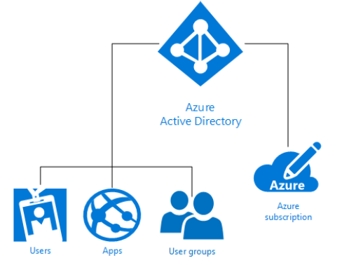
Azure AD & Azure subscription
A single Azure AD directory is automatically associated with an Azure subscription when it is created.
As the identity service in Azure, Azure AD then provides all identity management and access control functions for cloud-based resources.
These resources can include users, apps, and groups for an individual tenant (organization) as shown in the following diagram:
Each Azure subscription is associated with one Azure Active Directory (AD) directory

Slide 18
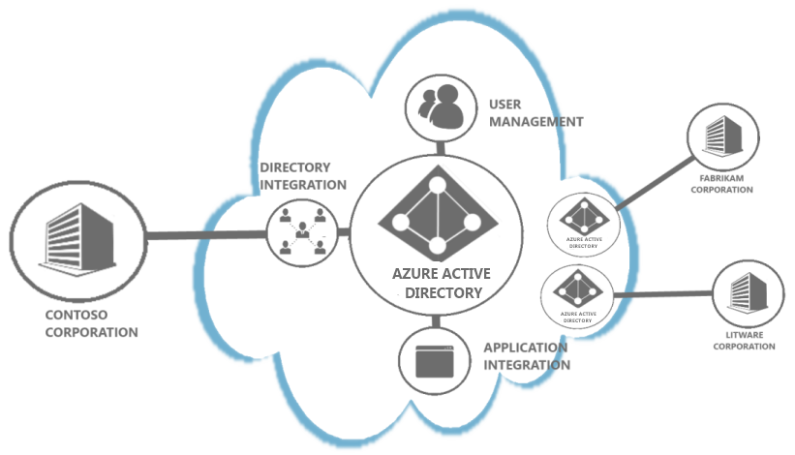
What is an Azure AD Tenant?
In Azure Active Directory (Azure AD), a TENANT is representative of an organization.
It is a dedicated instance of the Azure AD service that an organization receives and owns when it signs up for a Microsoft cloud service such as Azure, Microsoft Intune, or Office 365.
The default namespace/domain for any Azure AD tenant is <TenantName>.OnMicrosoft.com
Tenant level isolation
Each Azure AD directory is distinct and separate from other Azure AD directories. Just like a corporate office building is a secure asset specific to only your organization, an Azure AD directory was also designed to be a secure asset for use by only your organization
Tenant level isolation in Microsoft Azure is achieved using Azure Active Directory and role-based controls offered by it.
Each Azure subscription is associated with one Azure Active Directory (AD) directory
Users, groups, and applications from that directory can manage resources in the Azure subscription.
An Azure AD tenant is logically isolated using security boundaries so that no customer can access or compromise co-tenants, either maliciously or accidentally.
Azure AD runs on “bare metal” servers isolated on a segregated network segment, where host-level packet filtering and Windows Firewall block unwanted connections and traffic
aka.ms/Azure/Tenant
Notes:
A good way to describe a Tenant is to use an Apartment on a building.
Imagine, you have an apartment, you are the only one that owns the keys, however your apartment is on a building where other customers have their apartments.
https://docs.microsoft.com/en-us/azure/security/azure-isolation#tenant-level-isolation
Each Azure AD directory is distinct and separate from other Azure AD directories. Just like a corporate office building is a secure asset specific to only your organization, an Azure AD directory was also designed to be a secure asset for use by only your organization. The Azure AD architecture isolates customer data and identity information from co-mingling. This means that users and administrators of one Azure AD directory cannot accidentally or maliciously access data in another directory
Tenant level isolation in Microsoft Azure is achieved using Azure Active Directory and role-based controls offered by it. Each Azure subscription is associated with one Azure Active Directory (AD) directory
Users, groups, and applications from that directory can manage resources in the Azure subscription. You can assign these access rights using the Azure portal, Azure command-line tools, and Azure Management APIs. An Azure AD tenant is logically isolated using security boundaries so that no customer can access or compromise co-tenants, either maliciously or accidentally. Azure AD runs on “bare metal” servers isolated on a segregated network segment, where host-level packet filtering and Windows Firewall block unwanted connections and traffic

Slide 19
Tenant level isolation (Cont.)
Tenant level isolation (cont.)
Tenants are discrete containers and there is no relationship between them.
No access across tenants unless tenant admin grants it through federation or provisioning user accounts from other tenants
Physical access to servers that comprise the Azure AD service, and direct access to Azure AD’s back-end systems, is restricted
Azure AD users have no access to physical assets or locations, and therefore it is not possible for them to bypass the logical RBAC policy checks.
Notes:
https://docs.microsoft.com/en-us/azure/security/azure-isolation#tenant-level-isolation

Slide 20
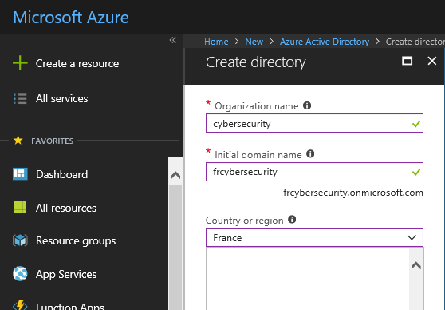
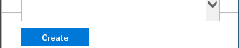
How to get an Azure AD Tenant
Multiple possibilities :
Have an existing Office 365/EMS subscription.
Have an existing Azure subscription associated with a Microsoft Account. (Example: john@Hotmail.com)
Have an existing Azure subscription associated with an organizational account.
If you have signed up for an Azure subscription with your organizational account, you already have a tenant.
Have none of the above & want to start from scratch:
then access https://account.windowsazure.com/organization to sign up for Azure with a new organization.
Main step for creating a new Azure AD tenant (from an alternate Azure subscription) :
Go to https://portal.azure.com , log in with an account that has already an Azure subscription associated
Click New button at the top of the page.
In the search textbox, type Azure Active Directory.
Click Create at the bottom of the blade.
In the Create directory page, enter an Organization name, and an Initial domain name. For country or region, choose your country or region.
Click Create. The creation process will start and it will take a moment to finish.
Notes:
Have an existing Office 365/EMS subscription
If you have a paid subscription to Office 365, Microsoft Dynamics CRM Online, Enterprise Mobility Suite, or other Microsoft services, you have a free subscription to Azure Active Directory. To manage the Azure AD through Azure management portal, you have to complete one-time registration process
Have an existing Azure subscription associated with a Microsoft Account(Eg: john@Hotmail.com)
If you sign-up for Azure subscription using Microsoft account (Live/Hotmail..) ,you get access to default directory and can add/manage Users within the Directory.
You will be able to add additional Azure Active Directories
You can add an existing Azure AD and manage the same.
Have an existing Azure subscription associated with an organizational account
If you have signed up for an Azure subscription with your organizational account, you already have a tenant.
Have none of the above & want to start from scratch
Access https://account.windowsazure.com/organization to sign up for Azure with a new organization.
OR through
https://docs.microsoft.com/en-us/rest/api/datacatalog/create-an-azure-active-directory-tenant

Slide 21
Domains in Azure AD
Recall : Azure AD directory
Each Azure tenant has a dedicated, trusted Azure AD directory that contains the tenant’s users, groups, and applications.
It is used to perform identity and access management functions for tenant resources.
Because a unique Azure AD directory is automatically provisioned to represent your organization when you sign up for a Microsoft cloud service like Azure, Microsoft Intune, or Office 365, you’ll sometimes see the terms tenant, Azure AD, and Azure AD directory used interchangeably.
Domains in Azure AD
An Azure AD domain is the boundary for configuration options
Federated or standard (managed)
Password policy
Used for Home Realm Discovery (HRD)
Every tenant is assigned <tenantname>.onmicrosoft.com as the default/initial routing domain name (Default Namespace)
Cloud identities are created with this domain
In addition to the default domain, custom domains can be added
Custom domains should be internet routable and ownership need to be verified
Be aware : Azure AD domain != AD DS Domain
In AD DS, domain/forest is security, storage, and trust boundary
In Azure AD, domain is more synonymous with a DNS domain (namespace)

Slide 22
Domains in Azure AD (Cont.)
Custom domains in Azure AD
Custom domains need to be registered with Azure AD to allow users to sign in with anything other than <tenantname>.onmicrosoft.com.
Domains must be public (Custom domains should be internet routable and ownership need to be verified).
Ownership must be verified via DNS.
New TXT or MX record with a value provided by Azure AD
Multiple domains can be registered with a single tenant.
Beware the parent/child relationship.

Slide 23


User Principle Name (UPN) Alignment
Required when a domain is federated
What is an Organization ID ?
User identifier in Azure Active Directory
In fact, the only way users identify themselves to AAD
Users need to know it their identifier, even when federated
We cannot support simple username or DOMAIN\User
someone@example.com
Domain must be registered as alternate UPN suffix in Active Directory
User Principle Name (UPN) Alignment requirement
User Principal Name = Organization ID
This is required for federated authentication.
You can also use alternate loginID …
If current UPN suffix is private, it has to change
Public domain must be registered as an alternate UPN suffix in Active Directory.
Users need to be updated, which could cause problems.
UPN suffix must be assigned to any user authenticating through federated authentication
Ideally, Organization ID = SMTP Address = SIP Address
Notes:
You can also use alternate loginID, but beware, it is not supported in Exchange Hybrid Environment.
For information about using alternate login IDs with AAD, see: http://social.technet.microsoft.com/wiki/contents/articles/24096.dirsync-using-alternate-login-ids-with-azure-active-directory.aspx

Slide 24
Azure Active Directory Editions & Licencing
Azure Active Directory comes in four editions : Free, Basic, Premium P1, and Premium P2.
Free
Basic
Premium P1
Premium P2 adds two additional features (Identity Protection & Privileged Identity Management)
EMS (E3 or E5) includes Azure AD :
EMS E3: includes Azure AD Premium P1 and additional features (Intune, AIP P1, ATA)
EMS E5: includes Azure AD Premium P2 and additional features (Intune, AIP P2, ATA, Cloud App Security)
Notes:
Azure Active Directory comes in four editions : Free, Basic, Premium P1, and Premium P2.
The Free edition is included with an Azure subscription, as well as Office 365
The Basic and Premium editions are available through a Microsoft Enterprise Agreement, the Open Volume License Program and the Cloud Solution Providers program
Azure and Office 365 subscribers can also buy Active Directory Premium online
More details:
Azure Active Directory editions
Pricing and licensing: https://azure.microsoft.com/en-us/pricing/details/active-directory/
Licences:
For details on EMS licenses, see https://www.microsoft.com/en-us/cloud-platform/enterprise-mobility-security-pricing
For details on Azure AD Premium licenses, see https://azure.microsoft.com/en-us/pricing/details/active-directory/
For details on Office 365 licenses, see https://products.office.com/en/business/compare-more-office-365-for-business-plans

Slide 25

Azure Active Directory Basic and Premium
Built on top of the free offering, provides a robust set of capabilities to empower enterprises with demanding needs on identity and access management
Additionally, Azure AD premium offers:
Self-Service Group and app Management/Self-Service application additions/Dynamic Groups
Self-Service Password Reset/Change/Unlock with on-premises password write-back
Multi-Factor Authentication – Cloud and On-premises (MFA Server)
MIM CAL+MIM Server
Cloud App Discovery
Connect Health
Notes:
Azure AD Connect is the primary tool to onboard to Azure AD
Express settings gets customers connected in a matter of minutes
Provides install & configuration of password sync/ADFS for sign-in
All future investments will only be available with Azure AD Connect
Authenticating to Azure AD
Enable password hash synchronization so that the Azure AD password for users is the same as the on-premises AD password
Otherwise, users will have different passwords for AD and Azure AD
Authenticating to an On-premises identity provider
Azure AD supports the ability to establish an identity federation trust with an on-premises Identity Provider (IdP), such as Active Directory Federation Services (AD FS)
This enables users to have a desktop single sign-on experience when accessing resources that are integrated with Azure AD

Slide 26
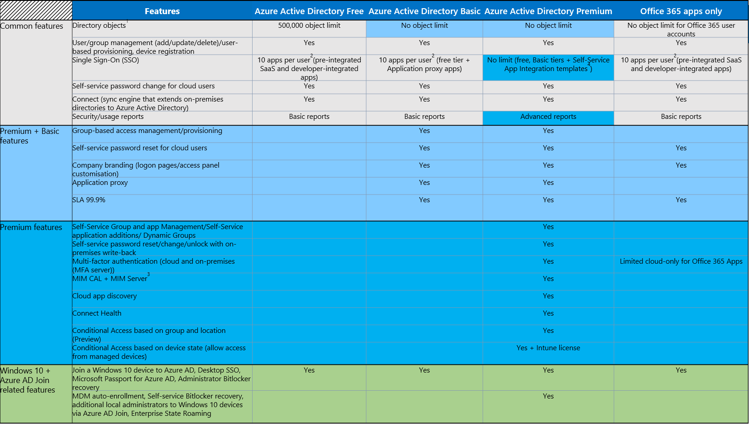
Azure Active Directory Editions Feature Comparison
The up-to-date & full table is available here : https://azure.microsoft.com/en-us/pricing/details/active-directory/
Notes:
Please open the following link to show the latest & up-to-date tables with the different features on AAD Versions: https://azure.microsoft.com/en-us/pricing/details/active-directory/
The number of objects that can be synchronized is a different value, and can go up to 500.000, however it may be increased on request subject to approval.

Slide 27

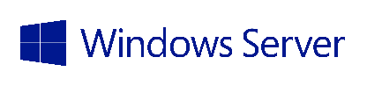
Understanding Synchronization and Federation
Active Directory
Synchronization
Active Directory
User attributes are synchronized including the password hash, authentication can be completed against either Azure or Windows Server Active Directory
Write back attributes to support cloud first and coexistence
Identity Sync with password hash sync
Federation
Identity Sync
Active Directory
Active Directory
User attributes are synchronized, Authentication is passed back through federation and completed against Windows Server Active Directory
AD FS provides conditional access to resources, Work Place Join for device registration and integrated Multi-Factor Authentication
AD FS
Notes:
When it comes to creating single identity across on-premises and in the cloud, you have options around sync and federation. The key question here is, where do you want passwords stored?
In the Sync model, identity information is kept in sync between the two locations, including passwords. Authentication can occur against either directory.
In the Federation model, identity information is kept in sync, but passwords are not. All authentication is passed back to on-premises AD DS to validation.
All authentication to Azure AD is performed against the on-premises directory via Active Directory Federation Services (AD FS) or another federated identity provider.
Works with non-Microsoft identity providers.

Slide 28
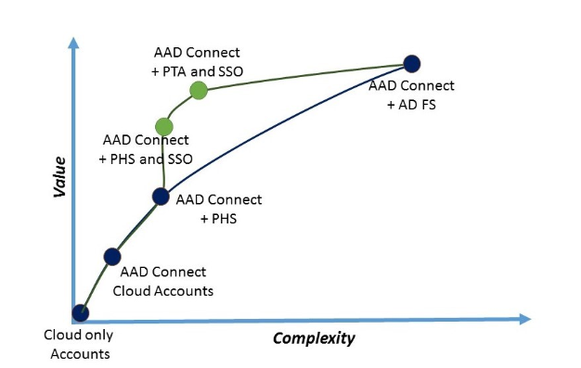
Azure AD Authentication option (the full picture)
Cloud only accounts:
User accounts are maintained and authenticated in Azure AD.
AAD Connect / Cloud Accounts:
You can use Azure AD Connect to sync user accounts into Azure AD so the login id (usually the user’s email address) is the same, but the users must maintain their own passwords in the cloud service.
AAD Connect + PHS (user sign-in based on PHS):
When you turn on the password hash synchronization optional feature in Azure AD Connect, the user password hashes stored in your on-premises Active Directory will be synchronized into Azure AD, thus enabling same sign-on.
If combined with Seamless SSO feature
Domain joined PC on the corporate network can use Kerberos authentication against Azure AD (using effective SSO)
AAD Connect + PTA (user sign-in based on PTA):
PTA enables users to login to cloud resources by validating their password against their on-premises local Active Directory (without the need to install AD FS). The used authentication protocols are the ones available on-premises (NTLM/Kerberos)
No password hashes stored in Azure AD / All authentication happens against on-prem AD
Can be also combined with Seamless SSO
When users are accessing applications on their corporate machines inside their corporate network, they don't need to type in their passwords to sign in.
AAD Connect + AD FS:
The most complete and most complex solution, this combination will provide SSO (single sign-on) to Azure AD. All authentications happens against on-prem AD.
Azure AD Authentication choices
Notes:
Azure Active Directory (Azure AD) Connect allows your users to sign in to both cloud and on-premises resources by using the same passwords.
This section describes key concepts for each identity model to help you choose the identity that you want to use for signing in to Azure AD.
If you’re already familiar with the Azure AD identity model and want to learn more about a specific method, see the appropriate link:
Password hash synchronization with Seamless Single Sign-on (SSO)
Pass-through authentication with Seamless Single Sign-on (SSO)
Federated SSO (with Active Directory Federation Services (AD FS))
Federation with PingFederate

Slide 29

The Azure AD Identity Models :
New Identity Models
There are 5 design options to consider for enabling users to authenticate to cloud services.
Who is the authority for authenticating the user, AAD or AD , that is the question !
Managed Identities
Federated Identities
Managed Identities
Pure Cloud Identity
Synchronized Identity (Password Hash Sync)
Federated Identity
Pass-Through Authentication
AAD Seamless SSO (is combined with PHS or PTA)
Azure Active Directory
Azure Active Directory
Azure Active Directory
Azure Active Directory
Azure Active Directory
Azure AD App Proxy Connector
Directory Sync and Password Sync
Directory Sync
Federation
Directory Sync
Directory Sync
Kerberos AuthN
Active Directory
Active Directory
Active Directory
Active Directory
Independent cloud identity
Single identity, enabling a sign-on like experience with password hash sync
Single identity, enabling single sign-on and additional flexibility
Single identity, enabling single sign-on in some scenarios and additional flexibility
True Single Sign-On (SSO) without ADFS.
Password stored in the cloud
Hash of Password hash stored in the cloud
Password stored on-premises
Password stored on-premises
Is combined with PHS or PTA
Notes:
Reference : https://blogs.msdn.microsoft.com/samueld/2017/06/13/choosing-the-right-sign-in-option-to-connect-to-azure-ad-office-365/
As part of setting up a Common Identity, there are 5 design options to consider for enabling users to authenticate to cloud services:
Cloud Identity: the user identities and associated passwords reside in the cloud and no synchronization takes place with the on-premises Active Directory. In this case, authentication always occurs in the cloud and the users must use a separate password from the one used on-premises. This is the simplest scenario as there is no need to synchronize user identities from the on-premises Active Directory domains to the cloud.
Synchronized Identity: the user identities and associated passwords are synchronized from the on-premises Active Directory to the Microsoft Azure Active Directory. In this case, the same password can be used to authenticate the user either in the cloud or on-premises depending on what resource is being accessed. This scenario requires the use of the Azure Active Directory Synchronization Service (AAD Sync) with password hash synchronization enabled.
Federated Identity: all authentication is retained on-premises and all passwords are stored on-premises only. All authentication traffic is redirected from Azure Active Directory to the on-premises Active Directory Federation Service (AD FS), which authenticates the user against a trusted Active Directory domain. This scenario requires the use of a federation service provider such as Active Directory Federation Service (AD FS) in addition to AAD Sync.
Pass-through Authentication
What is Azure Active Directory pass-through authentication?
Allowing your users to use the same credentials (passwords) to sign in to both on-premises resources and cloud-based services benefits them and your organization. Users have one less password to remember, which provides a better user experience. It also reduces the chances that users will forget how to sign in. Your help-desk costs then decrease, because password-related issues typically consume the most support resources.
Azure AD Seamless SSO
Azure Active Directory Seamless Single Sign On (Azure AD Seamless SSO) provides true single sign on for users signing in on their corporate desktops connected on the corporate network. When enabled, users won't need to type in their passwords to sign in to Azure AD, and in most cases, even type in their usernames. This feature provides your users easy access to your cloud-based services without needing any additional on-premises components.+
Seamless SSO can be enabled via Azure AD Connect and can be combined with either password synchronization or pass-through authentication.
To sum up :
Cloud only accounts
Simplest, great for testing or pilot
Password hash sync
Most common recommendation for organizations who want to use on prem identities in the cloud
Federated sign on with AD FS
Keeps passwords on prem and the identity provider under the organization’s control; with audit trail on prem; plus third party interoperability
Newest:
Pass through authentication and seamless SSO (combined with PTA or PHS)
Competitive, simplicity and light footprint

Slide 30
Azure AD Identity Models (1/5) – Cloud Identity overview
The user identities and associated passwords reside in the cloud and no synchronization takes place with the on-premises Active Directory.
In this case, authentication always occurs in the cloud
(Pure) Cloud Identity
Azure Active Directory
Sign-on
Active Directory
User
Independent cloud identity
Password stored in the cloud
Notes:
As part of setting up a Common Identity, there are some design options to consider for enabling users to authenticate to cloud services:
Cloud Identity: the user identities and associated passwords reside in the cloud and no synchronization takes place with the on-premises Active Directory. In this case, authentication always occurs in the cloud and the users must use a separate password from the one used on-premises. This is the simplest scenario as there is no need to synchronize user identities from the on-premises Active Directory domains to the cloud.

Slide 31
Azure AD Identity Models (2/5) – Synchronized Identity (Password Hash Sync) overview
same sign-on.
Password Synchronization
Synchronized Identity (Password Hash Sync)
User accounts
Active Directory
Azure AD Connect
Azure Active Directory
Sign-on
On-premises
directory
Directory Sync and Password Sync
Active Directory
Single identity, enabling a sign-on like experience with password hash sync
User
Hash of Password hash stored in the cloud
Notes:
Synchronized Identity: the user identities and associated passwords are synchronized from the on-premises Active Directory to the Microsoft Azure Active Directory. In this case, the same password can be used to authenticate the user either in the cloud or on-premises depending on what resource is being accessed. This scenario requires the use of the Azure Active Directory Synchronization Service (AAD Sync) with password hash synchronization enabled.
Password Synchronization (Optional*)
Helps provide rich experience with Office 365 applications.
Directory synchronization between on-premises and online.
Identities are created and managed on-premises and synchronized to the cloud.
Single identity and credentials but no single Sign-On for on-premises and office 365 services.
Reuse existing directory implementation on-premises.
* If Password Synchronization is not enabled, the user will need to maintain 2 password for the same account. One on-premises and one on Cloud

Slide 32
Azure AD Identity Models (3/5) – Federated Identity overview
single sign-on with AD FS
Password hashes
Federated Identity
User accounts
Active Directory
Azure AD Connect
Sign-on
5
Azure Active Directory
Authentication
AD FS
On-premises
directory
1
2
Directory Sync
Federation
Active Directory
Single identity, enabling single sign-on and additional flexibility
User
4
Authentication
3
Password stored on-premises
Notes:
Federated Identity: all authentication is retained on-premises and all passwords are stored on-premises only. All authentication traffic is redirected from Azure Active Directory to the on-premises Active Directory Federation Service (AD FS), which authenticates the user against a trusted Active Directory domain. This scenario requires the use of a federation service provider such as Active Directory Federation Service (AD FS) in addition to AAD Sync.
How it works
User enters username
Azure AD redirects the user to his AD FS Farm with WIA SSO or Forms based AuthN if connecting from outside of corporate network
AD FS validates the user credentials against on-premises AD
AD FS builds the SAML Token and returns it to the user (requestor)
The User Presents the token to Azure AD that validates the SAML Token and conclude the Authentication process.

Slide 33
Azure AD Identity Models (4/5) - Pass-Through Authentication (PTA) overview
single sign-on without ADFS
User accounts
Pass-Through Authentication
Active Directory
Azure AD Connect
Sign-on
Azure Active Directory
1
On-premises
directory
Azure AD App Proxy Connector
Agent
Directory Sync
Active Directory
User
2
Single identity, enabling single sign-on in some scenarios and additional flexibility
3
Password stored on-premises
Notes:
What is Azure Active Directory pass-through authentication?
The Azure AD pass-through authentication feature provides a simple solution for these organizations. When users sign in to Azure AD, this feature ensures that users' passwords are directly validated against on-premises Active Directory.
**bullet points
What is it
Credentials validation happens on-prem
Passwords are never stored in the cloud
No dependency of federation identity model
Requirements and Configuration
Windows 2012r2 (or higher)
AD Connect v1.1.486.0 (or higher)
Outbound TCP/UDP 80/443
How it works:
User Enters username and password into the Azure AD sign-in page.
AAD places the username and password (encrypted using a public key) on a queue, which the on-premises Pass-through Authentication agent retrieves and validates against the local DC
The DC evaluates the request and returns the appropriate response (success, failure, password expired or user locked out) to the agent
AAD validates the response and concludes the authentication process (may request MFA if needed).
The details of the interactions can be found here: https://docs.microsoft.com/en-us/azure/active-directory/connect/active-directory-aadconnect-pass-through-authentication-how-it-works

Slide 34
Azure Identity Models (5/5) – Seamless SSO (in combination with PHS or PTA) - Overview
single sign-on.
Domain joined PC on the corporate network can use Kerberos authentication against Azure AD (using effective SSO)
User accounts
AAD Seamless SSO (with PHS or PTA)
Active Directory
Azure AD Connect
Sign-on
5
Azure Active Directory
2
1
On-premises
directory
Directory Sync
Kerberos AuthN
Active Directory
4
User
True Single Sign-On (SSO) without ADFS.
3
33
Notes:
What is Azure Active Directory Seamless Single Sign On?
Azure Active Directory Seamless Single Sign On (Azure AD Seamless SSO) provides true single sign on for users signing in on their corporate desktops connected on the corporate network. When enabled, users won't need to type in their passwords to sign in to Azure AD, and in most cases, even type in their usernames. This feature provides your users easy access to your cloud-based services without needing any additional on-premises components.
Seamless SSO can be enabled via Azure AD Connect and can be combined with either password synchronization or pass-through authentication.
What is Single Sign-On?
True Single Sign-On (SSO) without ADFS
No additional servers or infrastructure required on premises
Accelerated deployment
Utilizes existing AD infrastructure
Inherit support for finding the closest Domain Controller (DC)
Based on Kerberos
No Disaster Recovery plan required outside of Active Directory (AD) Disaster recovery
SSO is provided for all domain joined corporate machines with line of sight to a DC
Can be used in addition to:
Pass-through authentication (PTA)
Password Hash Sync (PHS)
What does SSO offers over AD FS?
Less infrastructure to manage
No need for dedicated servers, load balancers or DMZ
Less to manage after deployment
Simple Disaster Recovery and High Availability story, no certificates to manage
How does it works?
The user tries to access an application from a domain-joined corporate device inside your corporate network by entering username into the Azure AD sign-in page.
Using JavaScript in the background, Azure AD challenges the browser, via a 401 Unauthorized response, to provide a Kerberos ticket
The browser, in turn, requests a ticket from Active Directory for the computer account
Active Directory locates the computer account and returns a Kerberos ticket to the browser encrypted with the computer account's secret.
The browser forwards the Kerberos ticket it acquired from Active Directory to Azure AD
Azure AD decrypts the Kerberos ticket, which includes the identity of the user signed into the corporate device, using the previously shared key.
After evaluation, Azure AD either returns a token back to the application or asks the user to perform additional proofs, such as Multi-Factor Authentication
For details, see: https://docs.microsoft.com/en-us/azure/active-directory/connect/active-directory-aadconnect-sso-how-it-works

Slide 35
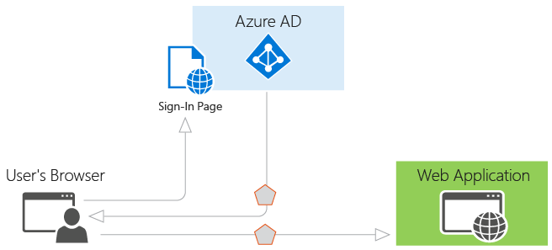
Basics of authentication in Azure AD
Azure AD is the identity provider :
responsible for verifying the identity of users and applications that exist in an organization’s directory,
and ultimately issuing security tokens upon successful authentication of those users and applications.
An application that wants to outsource authentication to Azure AD must be registered in Azure AD, which registers and uniquely identifies the app in the directory.
Developers can use the open source Azure AD authentication libraries to make authentication easy by handling the protocol details for you.
Once a user has been authenticated, the application must validate the user’s security token to ensure that authentication was successful for the intended parties.
Developers can use the provided authentication libraries to handle validation of any token from Azure AD, including JSON Web Tokens (JWT) or SAML 2.0.
Notes:
References: https://docs.microsoft.com/en-us/azure/active-directory/develop/active-directory-authentication-scenarios
If you want to go deeper, see type of applications https://docs.microsoft.com/en-us/azure/active-
directory/develop/active-directory-authentication-scenarios#application-types-and-scenarios

Slide 36
Client Authentication flow
Generaly speaking, the Azure AD authentication flow depends on :
The user sign-in method
The authentication protocol
and also on the client capabilities (client type/model) to engage the authentication to the identity provider (Azure AD or AD FS)
Passive Authentication (web browser case)
Active Authentication
Modern Authentication (Enables the Office clients to engage in browser-based authentication)

Slide 37
Modern Authentication clients : ADAL + OAUTH
What :
Modern authentication brings Active Directory Authentication Library (ADAL)-based sign-in to Office client apps across platforms.
OAuth-based authentication for Office clients against O365
Enables the Office clients to engage in browser-based authentication, where the user is directed to a web page from the identity provider to authenticate
Currently available in Office 365 however “opt-in” is service specific (SharePoint, Exchange, Skype, etc)
Enabled by default for tenants created after summer 2017.
Why
Prerequisite for Azure multi-factor authentication (MFA) for Office client applications.
Authentication can all take place inside of the corporate network.
Eliminates the need for basic credentials. No more sending username/password in clear text over SSL to the cloud.
Reduces the amount of authentication requests sent to the federation provider.
Employee leaves company scenario.
Legacy Authentication can coexist with Modern Authentication.
Compatible with most 3rd party IDPs.
Supported across multiple platforms: iOS, OS X, Android, Windows
(Oauth) Token based
Bearer / Access token
Valid for 1 hour
Used to access service
URL specific
Granted by Azure AD (login.windows.net)
Refresh token
Valid for 14 – 90 DAYS
Used to request a new access token
Good for all of Azure AD for specific UPN/Identity
Granted by Azure AD (login.windows.net)
Can be revoked
Password change
Account disablement
Etc.
Will trigger new auth sequence
Important : With Modern Auth, office clients look like “browser traffic” to on-prem STS (ADFS)
Notes:
ADAL is the acronym for the 'Active Directory Authentication Library' and, along with OAuth 2.0, it is an underpinning of Modern Authentication.
Azure Active Directory Authentication Libraries https://azure.microsoft.com/en-us/documentation/articles/active-directory-authentication-libraries/
The Azure AD authentication Library (ADAL) enables client application developers to easily authenticate users to cloud or on-premises Active Directory, and then obtain access tokens for securing API calls. ADAL has many features that make authentication easier for developers, such as asynchronous support, a configurable token cache that stores access tokens and refresh tokens, automatic token refresh when an access token expires and a refresh token is available, and more. By handling most of the complexity, ADAL can help developers focus on business logic in their application and easily secure resources without being an expert on security.
Customizing Token Lifetimes :
https://docs.microsoft.com/en-us/azure/active-directory/active-directory-configurable-token-lifetimes

Slide 38
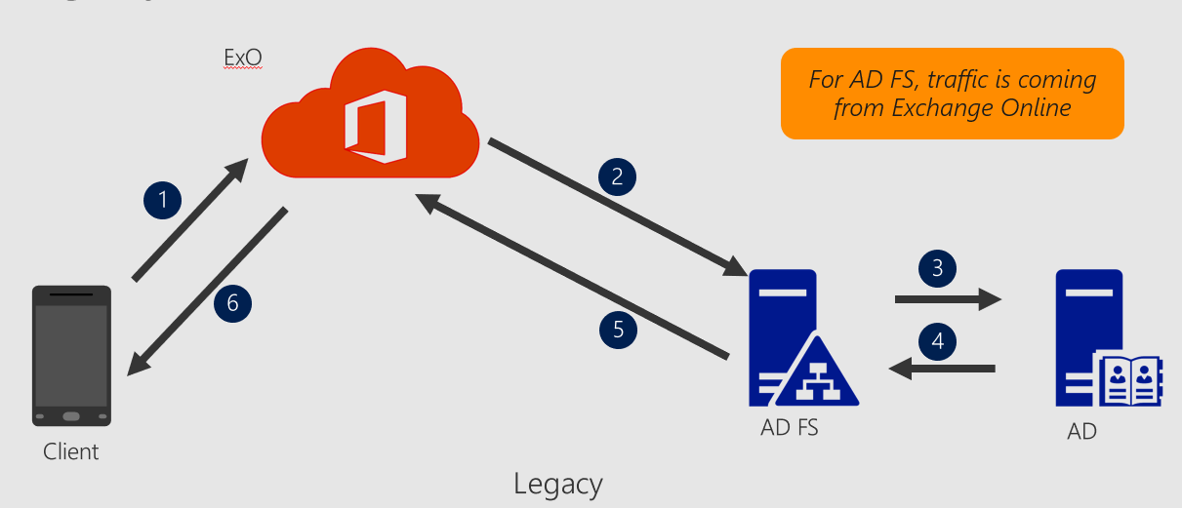
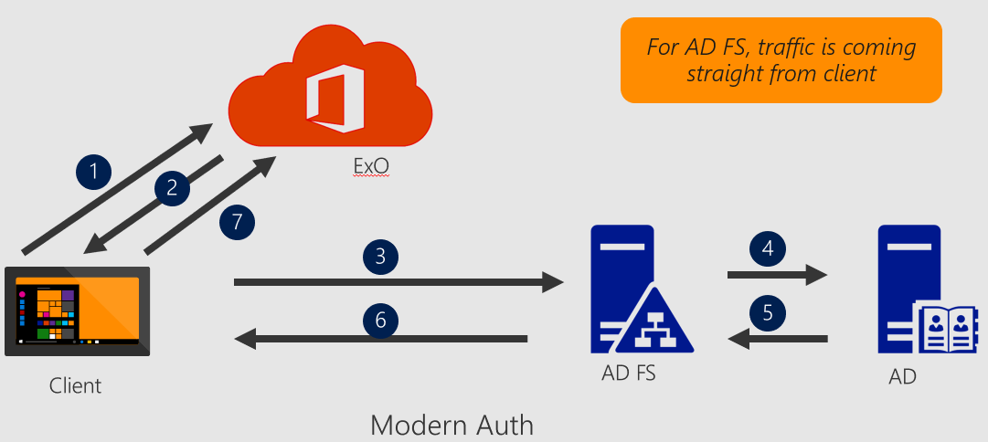
Basic vs Modern Authentication (outlook client example)
Basic Authentication: Outlook connects to Exchange Online using Basic authentication over HTTPS, which requires the credentials to be passed anytime a connection is made. Then Exchange Online proxying the credentials for authentication …
Modern Authentication (ADAL): Outlook communicates directly with the customer’s identity provider and no longer relies on Exchange Online proxying the credentials for authentication
ADAL uses OAuth standards and is supported on multiple platforms, including OS X, iOS, Android, and Windows.

Slide 39
Modern Authentication Flow - basics
Notes:
Office 2013 updated authentication enabling Multi-Factor Authentication and SAML identity providers https://blogs.office.com/2014/11/12/office-2013-updated-authentication-enabling-multi-factor-authentication-saml-identity-providers/
The ADAL-based authentication stack enables Office 2013 and Office 2016 clients to engage in browser-based authentication (also known as passive authentication) where the user is directed to a webpage from the identity provider to authenticate. The diagram on the slide shows the default webpage from Azure Active Directory (Azure AD), which is used by Office 365. This diagram shows how the updated Office 2013 Windows client applications enables user sign in. The Office 2013 and Office 2016 client applications use the ADAL component to facilitate sign-in with Azure AD. Azure AD hosts a web page where the user can sign in. The identity provider could be Azure AD or a federated identity provider such as Active Directory Federation Services (AD FS). If the user is a federated user, Azure AD redirects the user to the sign-in webpage hosted by the identity provider of record for the tenant. This identity provider is determined based on the domain as specified in the user’s sign-in name. The sign-in webpage is shown to the user on their device and the user signs in. The identity provider returns a token to Azure AD when the user is successfully signed in. Azure AD returns a JWT token to the Office client application and the client application can use this JWT token with Office 365 services on behalf of the user. There are several benefits to this approach, including that the Office client application never handles the user password, the identity provider can show multiple pages and custom user interfaces to the user, and customized sign-in can be enabled through integration with the identity provider.

Slide 40
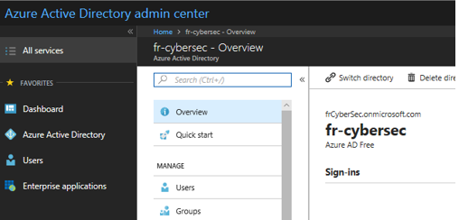
Azure AD Identity Management
Via Powershell
Dedicated Azure AD PowerShell module (PowerShell 3.0 or newer) : Install-Module AzureAD
Example
via the Azure Portal
Common task samples
Users | Groups | Other management tasks
Add new users | Manage groups | Assign licenses
Manage profiles | Manage group members | Manage Reports (sign-ins, Audit, users at risk, etc.)
Share Accounts | Manage group owners | Manage devices
Assign users to administrative roles | Manage group membership | Manage applications
Add guest users (B2B) | … | …
Manage passwords
…
Connect to Azure AD
$AzureAdCred = Get-Credential
Connect-AzureAD –Credential $AzureAdCred
To connect to a specific Azure AD environment
Connect-AzureAD – AzureEnvironment “EnvironmentName” (i.e contoso)
Recover deleted objects
Get-AzureADMSDeletedGroup
Get-AzureADDeletedApplication
Restore-AzureADMSDeletedDirectoryObject –Id <ObjectId>
Detailed references about the AzureAD PowerShell module: https://docs.microsoft.com/en-us/powershell/module/azuread/?view=azureadps-2.0
Notes:
A preview version of the Azure AD module is also available. More information: https://docs.microsoft.com/en-us/powershell/azure/active-directory/install-adv2?view=azureadps-2.0
via the Azure Portal
https://portal.azure.com
Or
https://aad.portal.azure.com

Slide 41
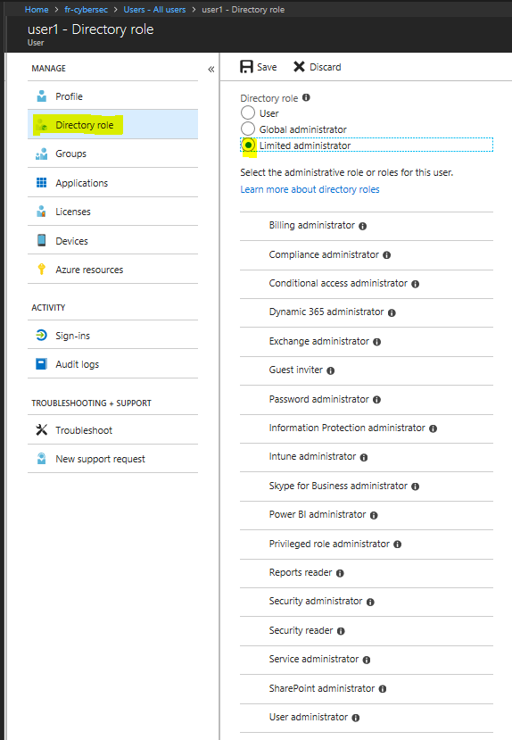
Role-Based Access Control (RBAC) – Roles in Azure AD
Several administrator roles available, like:
Billing Administrator
Conditional Access Administrator
Device Administrator
Directory Readers / Writers
Global Administrator
And many others
Roles can be assigned from the Users and Groups blade -> <Object> -> Directory role
Administrative units -> Container of resources that can be used for delegating administrative permissions over subsets of users and applying policies to a subset of users
Notes:
See https://docs.microsoft.com/en-us/azure/active-directory/role-based-access-control-what-is
For Administrative roles in Azure AD, see https://docs.microsoft.com/en-us/azure/active-directory/active-directory-assign-admin-roles-azure-portal
Conduct a general discussion around administrative roles available nowadays
Administrative units - https://docs.microsoft.com/en-us/azure/active-directory/active-directory-administrative-units-management

Slide 42
AAD Identity management via Azure AD Graph API
Azure Active Directory Graph API provides programmatic access to Azure Active Directory through Odata REST API endpoints
just as ADSI or ADO.NET provides for Active Directory.
Developers/Applications can execute create, read, update, and delete (CRUD) operations on Azure Active Directory objects such as users and groups.
Graph Explorer to be replaced in the future by Microsoft Graph
Enables the following:
Line of Business Applications (LOB )
Multi-tenant apps that require Azure AD Access
Creating Reusable features that require Azure AD Access
Notes:
See https://docs.microsoft.com/en-us/azure/active-directory/develop/active-directory-graph-api-quickstart
Azure AD Graph API reference - https://msdn.microsoft.com/Library/Azure/Ad/Graph/api/api-catalog
Azure Active Directory Graph API
- https://docs.microsoft.com/en-us/azure/active-directory/develop/active-directory-graph-api
The Azure Active Directory Graph API provides programmatic access to Azure AD through REST API endpoints. Applications can use Azure AD Graph API to perform create, read, update, and delete (CRUD) operations on directory data and objects. For example, Azure AD Graph API supports the following common operations for a user object:
Create a new user in a directory
Get a user’s detailed properties, such as their groups
Update a user’s properties, such as their location and phone number, or change their password
Check a user’s group membership for role-based access
Disable a user’s account or delete it entirely
Additionally, you can perform similar operations on other objects such as groups and applications. To call Azure AD Graph API on a directory, your application must be registered with Azure AD. Your application must also be granted access to Azure AD Graph API. This access is normally achieved through a user or admin consent flow.

Slide 43
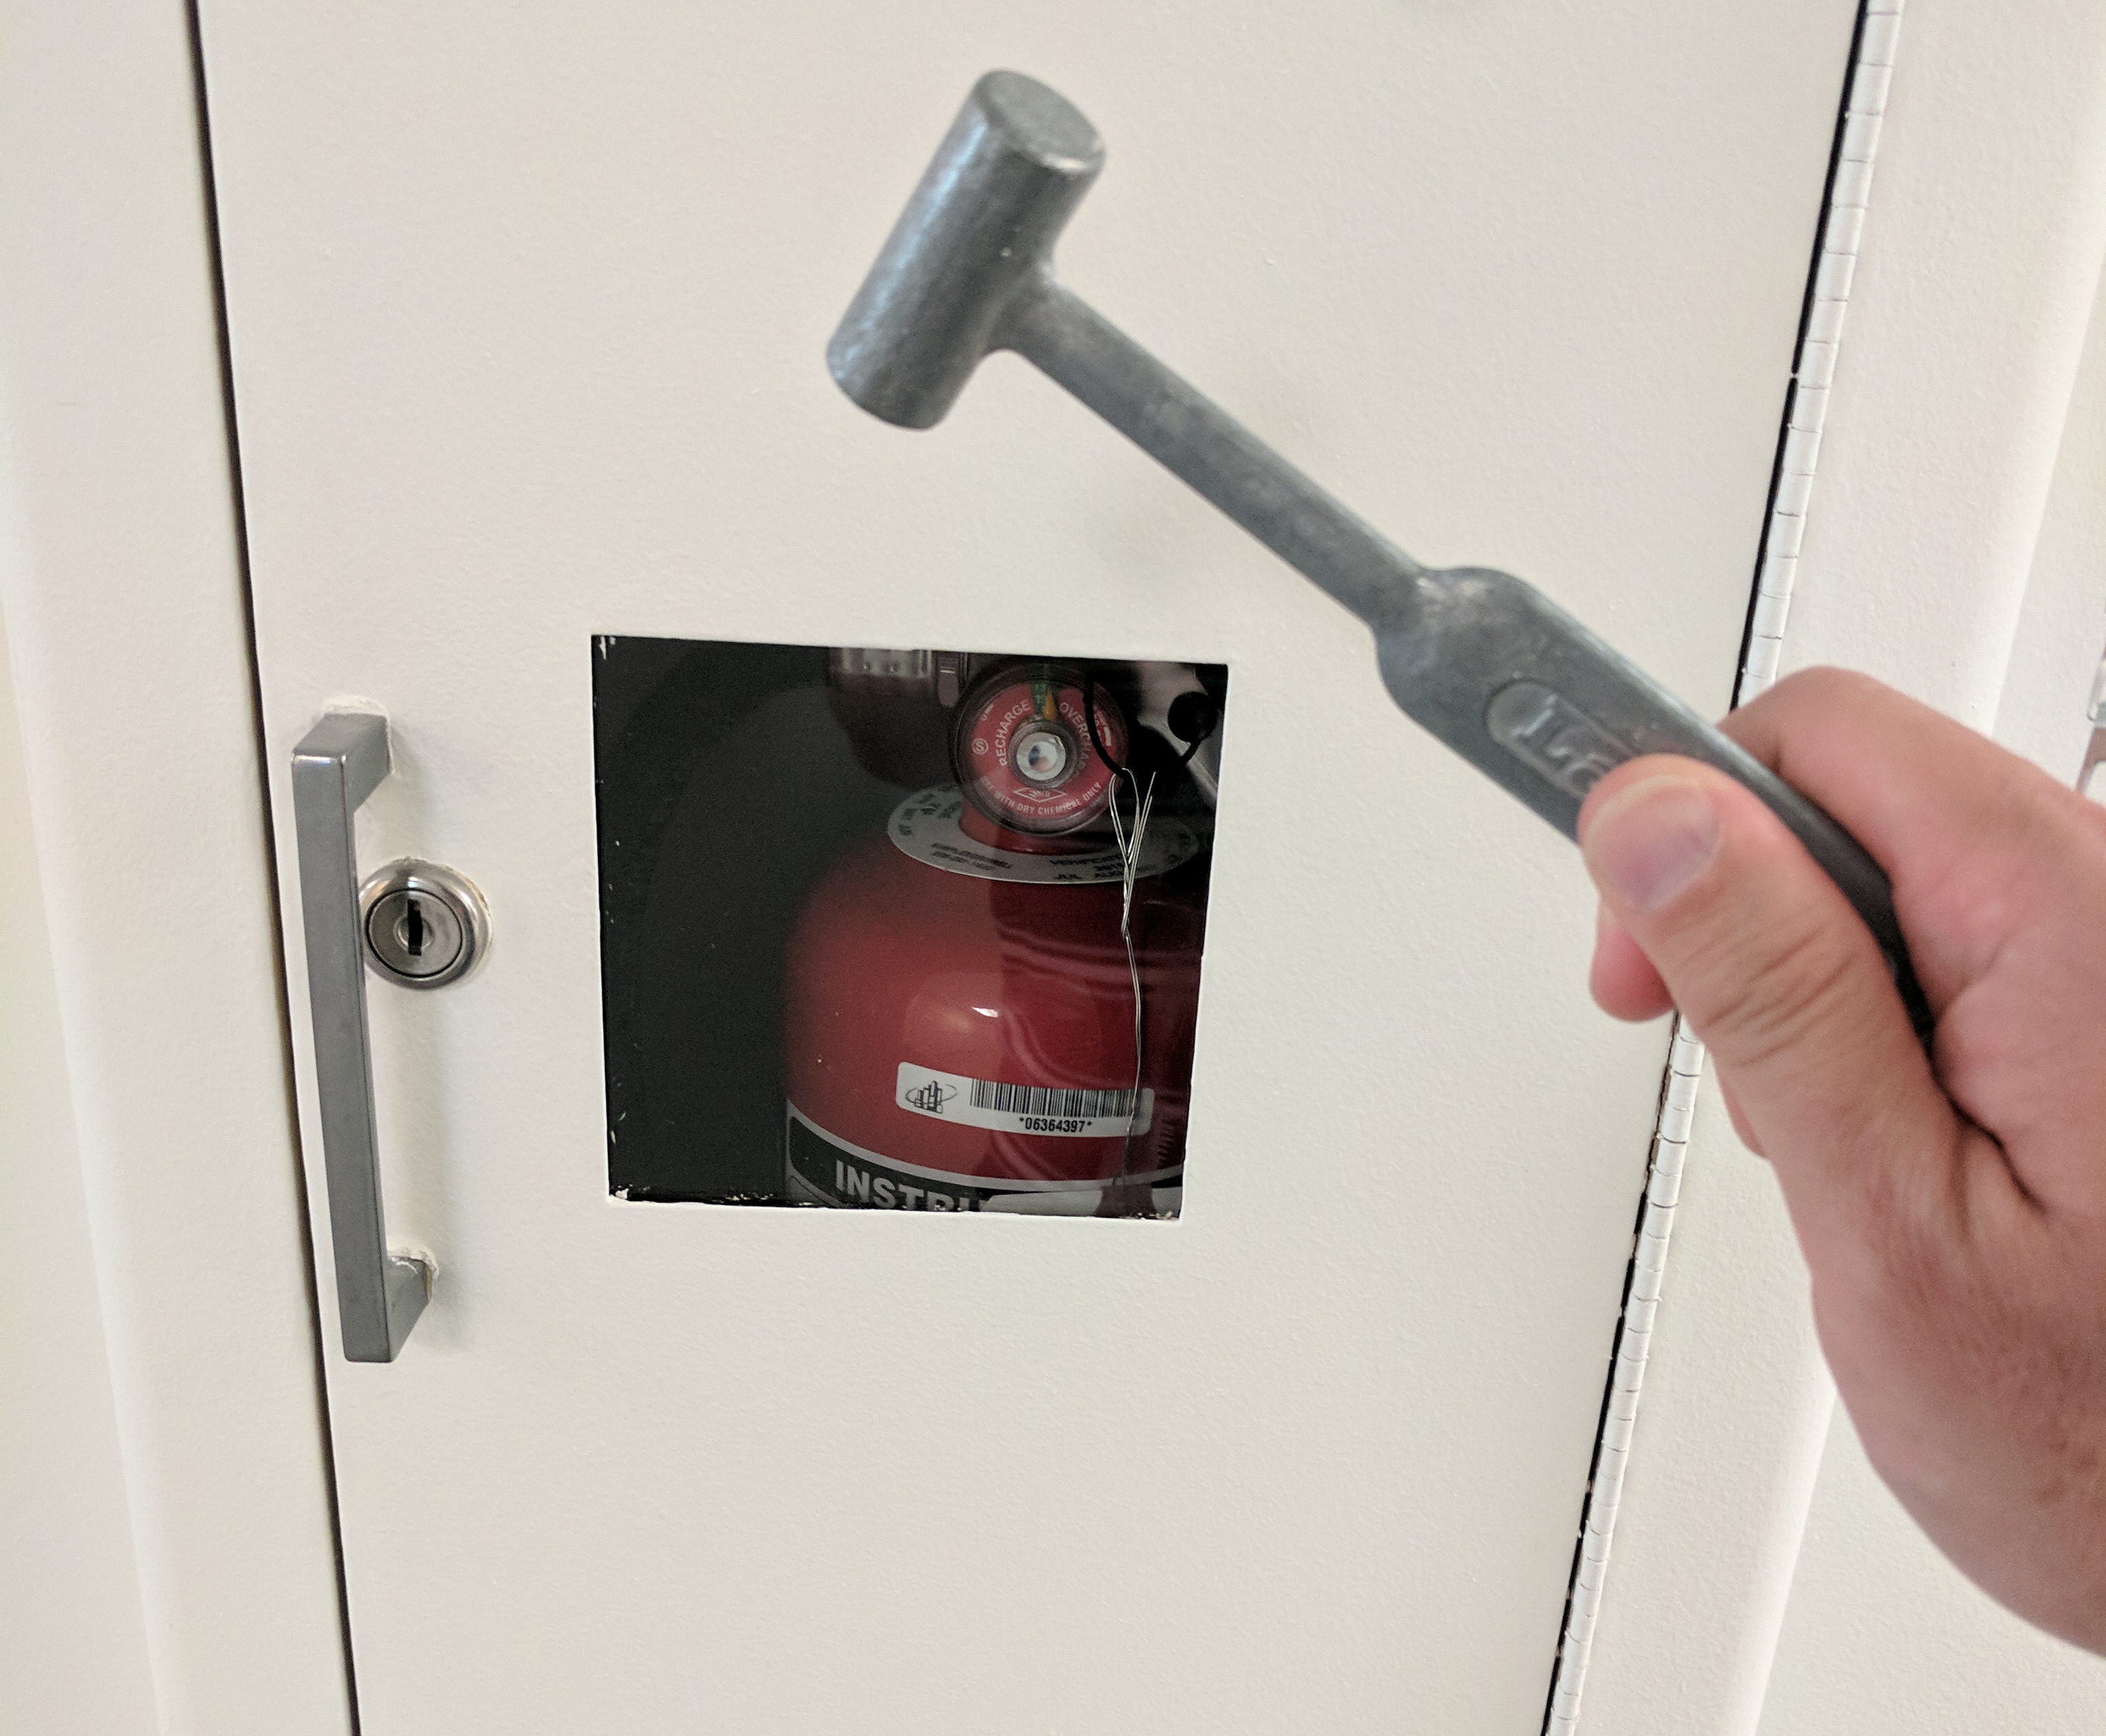
Best Practices for Locking Down Access
Make sure people automatically lose access when they leave
Use multi-factor authentication for all Azure users
Today’s #1 cyber weapon: good grammar
Use “break glass” accounts for Account & Service Admins
Do not use account for daily work
Write down strong random password and lock it away
Do not share password
Change password every time you use it and on scheduled basis
Enable per-user MFA
Give people minimum access needed for day to day work – RBAC and Azure Privileged Identity Management (PIM)
Use Managed Service Identity to keep credentials out of code

